Slide 1
AO Sports: Principles of Sports Medicine Resident Course 2024 AKA: AO Also Does Sports?
Brent Ponce, MD
Chair of Research, Hughston Foundation
Chair AO Sports
COERG Founder
Hughston Clinic
Columbus, GA
bponce@hughston.com
James Stannard, MD
Professor and Chair, University of Missouri Department of Orthopaedic
Past AO NA President
Past Chair AO Sports
Columbia, MO
stannardj@health.missouri.edu
Selina Ziswiler Project Manager AO Sports
selina.ziswiler@aofoundation.org
AO Sports Steering Committee Members: Andrea Achtnich MD, Heather Cannon, Bassem Elhassan MD,
Florian Gebhard MD , Martin Jaeger MD, Therese Kelley, Robert McGuire MD, Tim Pohlemann MD & Miho Tanaka MD
Notes:
The purpose of this presentation is to share about a new AO initiative, AO Sports.
Please note: Email addresses are given if you would like to have this presentation or have questions – please email one of us. This presentation is intended to be shared among your faculty – esp. if you area not a sports surgeon or the PD or Chair but feel your program would benefit; it is also intended to be shared to other colleagues from other institutions.

Slide 2
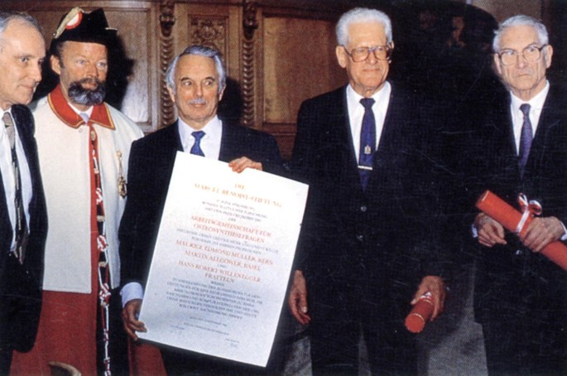

Overview
AO History
Newest AO Initiative - Sports
Courses and reviews
Grant process
Faculty Development
Notes:
The overview for this short presentation is as follows.
To give an overview of the history of AO,
To present the AO Sports initiative and then to introduce you to the AO Sports Principles course along with giving you some of the reviews from the participants.
Lastly, there is information regarding how the grant process works and some of the potential secondary benefits for your program and faculty.

Slide 3
First - Upcoming AO Sports Courses in the US
Principles Course – The Joint is an Organ
August 6-7, 2025 Nashville, TN
Advanced Management of Rotator Cuff Disease and Shoulder Instability
August 8-9, 2025 Nashville, TN
Advanced Course Knee Patellofemoral Disorder
Nov 14-15, 2025 San Diego, CA
For additional information visit https://www.aofoundation.org/our-services-and-resources/ao-sports

Slide 4
Question:
What percentage of US orthopaedic residents go to an AO Trauma course Basic Principles of Fracture Management course?

Slide 5
Answer:
95% go to an AO Trauma course Basic Principles of Fracture Management course

Slide 6
Answer:
95% of residents go to an AO Trauma course Basic Principles of Fracture Management course
Teaches fundamental principles and current concepts in the treatment of injuries, incorporating the latest techniques in operative fracture management from trauma experts and serves as the initial step along the path of lifelong learning in the area of operative fracture management.
Notes:
The goal of the Basic Principles of Fracture Management course is to teach the ”fundamental….
As these courses have been taught for decades, it is clear that the trauma basic course is a value gained proposition by orthopaedic training programs.

Slide 7
AO Sports Principles Course Goal
To teach the fundamental principles of sports medicine surgery, with focus on the knee and shoulder.
Applied knowledge of anatomy and biomechanics will assist in the diagnosis and management of sports injuries with a overarching recognition that the joint works as “an organ system.”
Participants will receive hands on training in arthroscopic and open treatment of common knee and shoulder pathology.
Notes:
In a similar fashion to the trauma basic course for residents, the goal of the AO Sports Principles Course is “To ….

Slide 8
Why an AO Sports Principles Course?
Largest subspecialty in orthopaedics
56% of the top eleven ABOS Part II certification procedures are arthroscopic.¹
Exposure is varied – both year in residency and quality of instruction
Sports is increasingly considered “general orthopaedics”
>40% of cases submitted for ABOS Part II certification were not sports related.²
1. Garrett et al JBJS 2006; 2. Inclan et al JBJS 2022

Slide 9
AO History
1950 Dr. Maurice E Müller gathered a small group of Swiss surgeons who shared his interests in researching bone healing.
1958 AO/ASIF established to champion internal fixation techniques.
- 1959 the 4 pillars were established:
Development of implants and instruments,
Research of fracture healing and tissue cultures,
Documentation of all patients,
Teaching of osteosynthesis techniques.

Slide 10
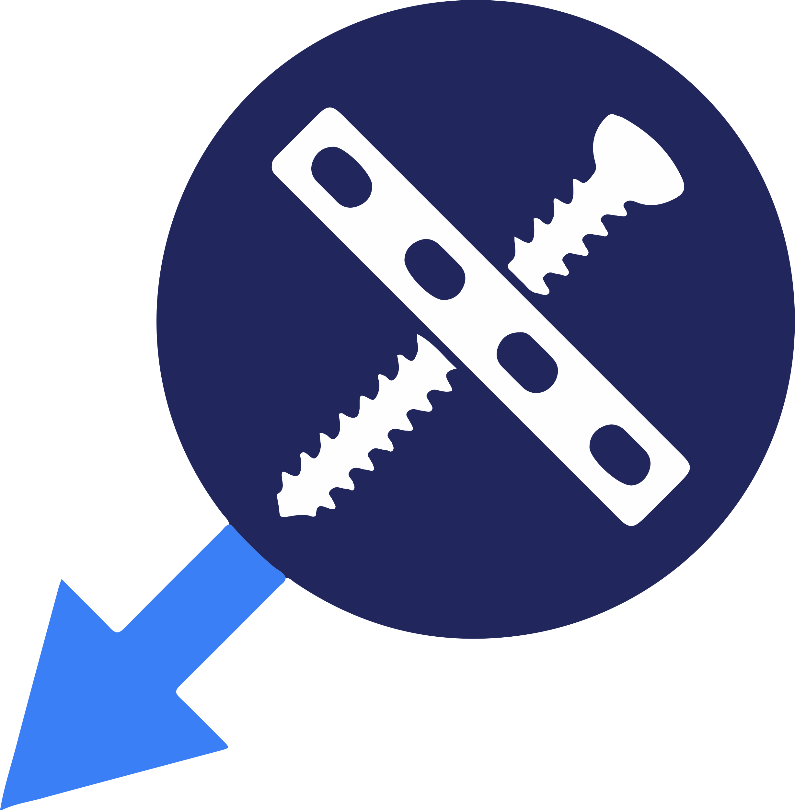
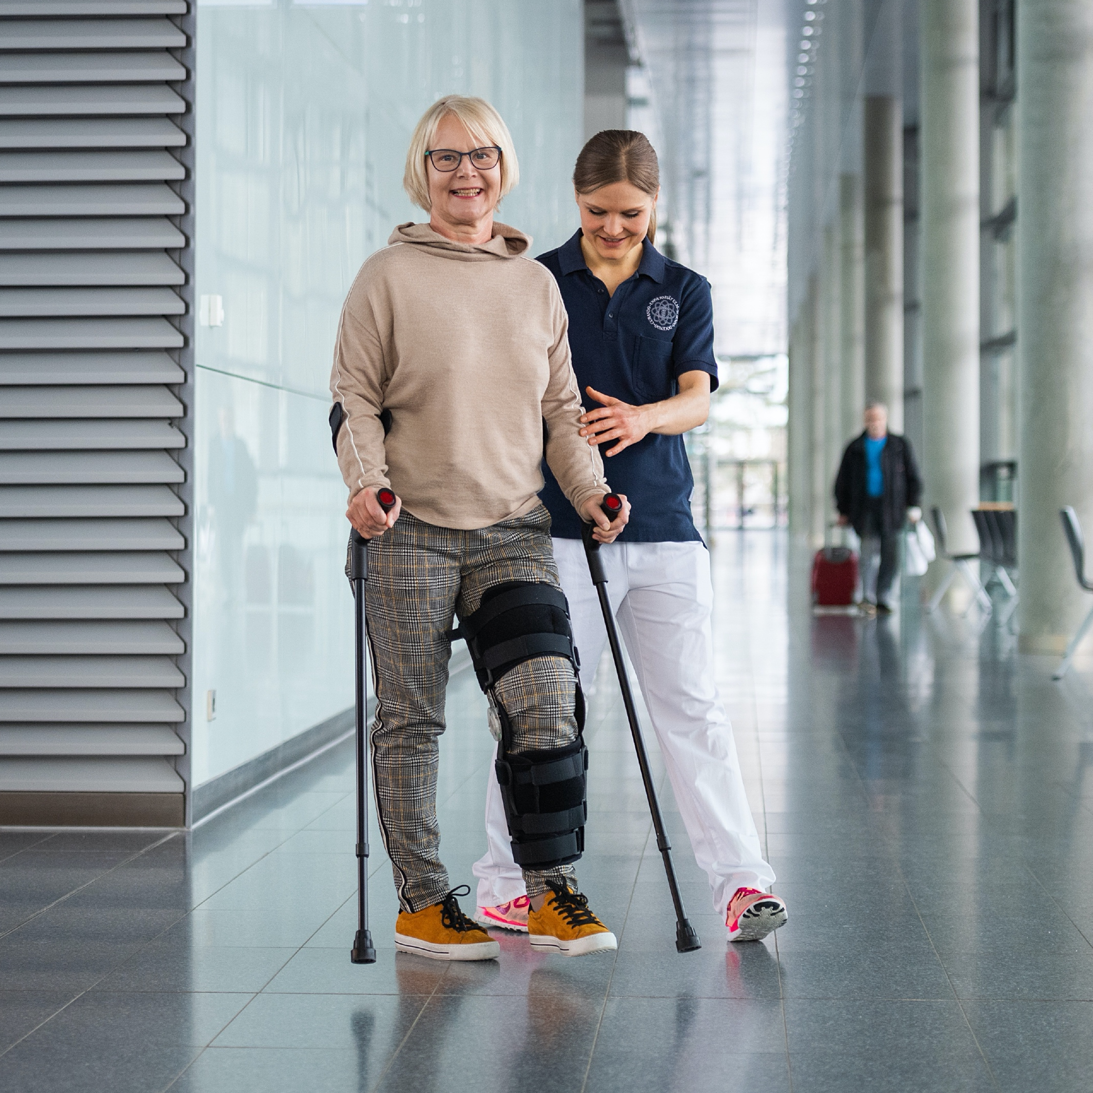
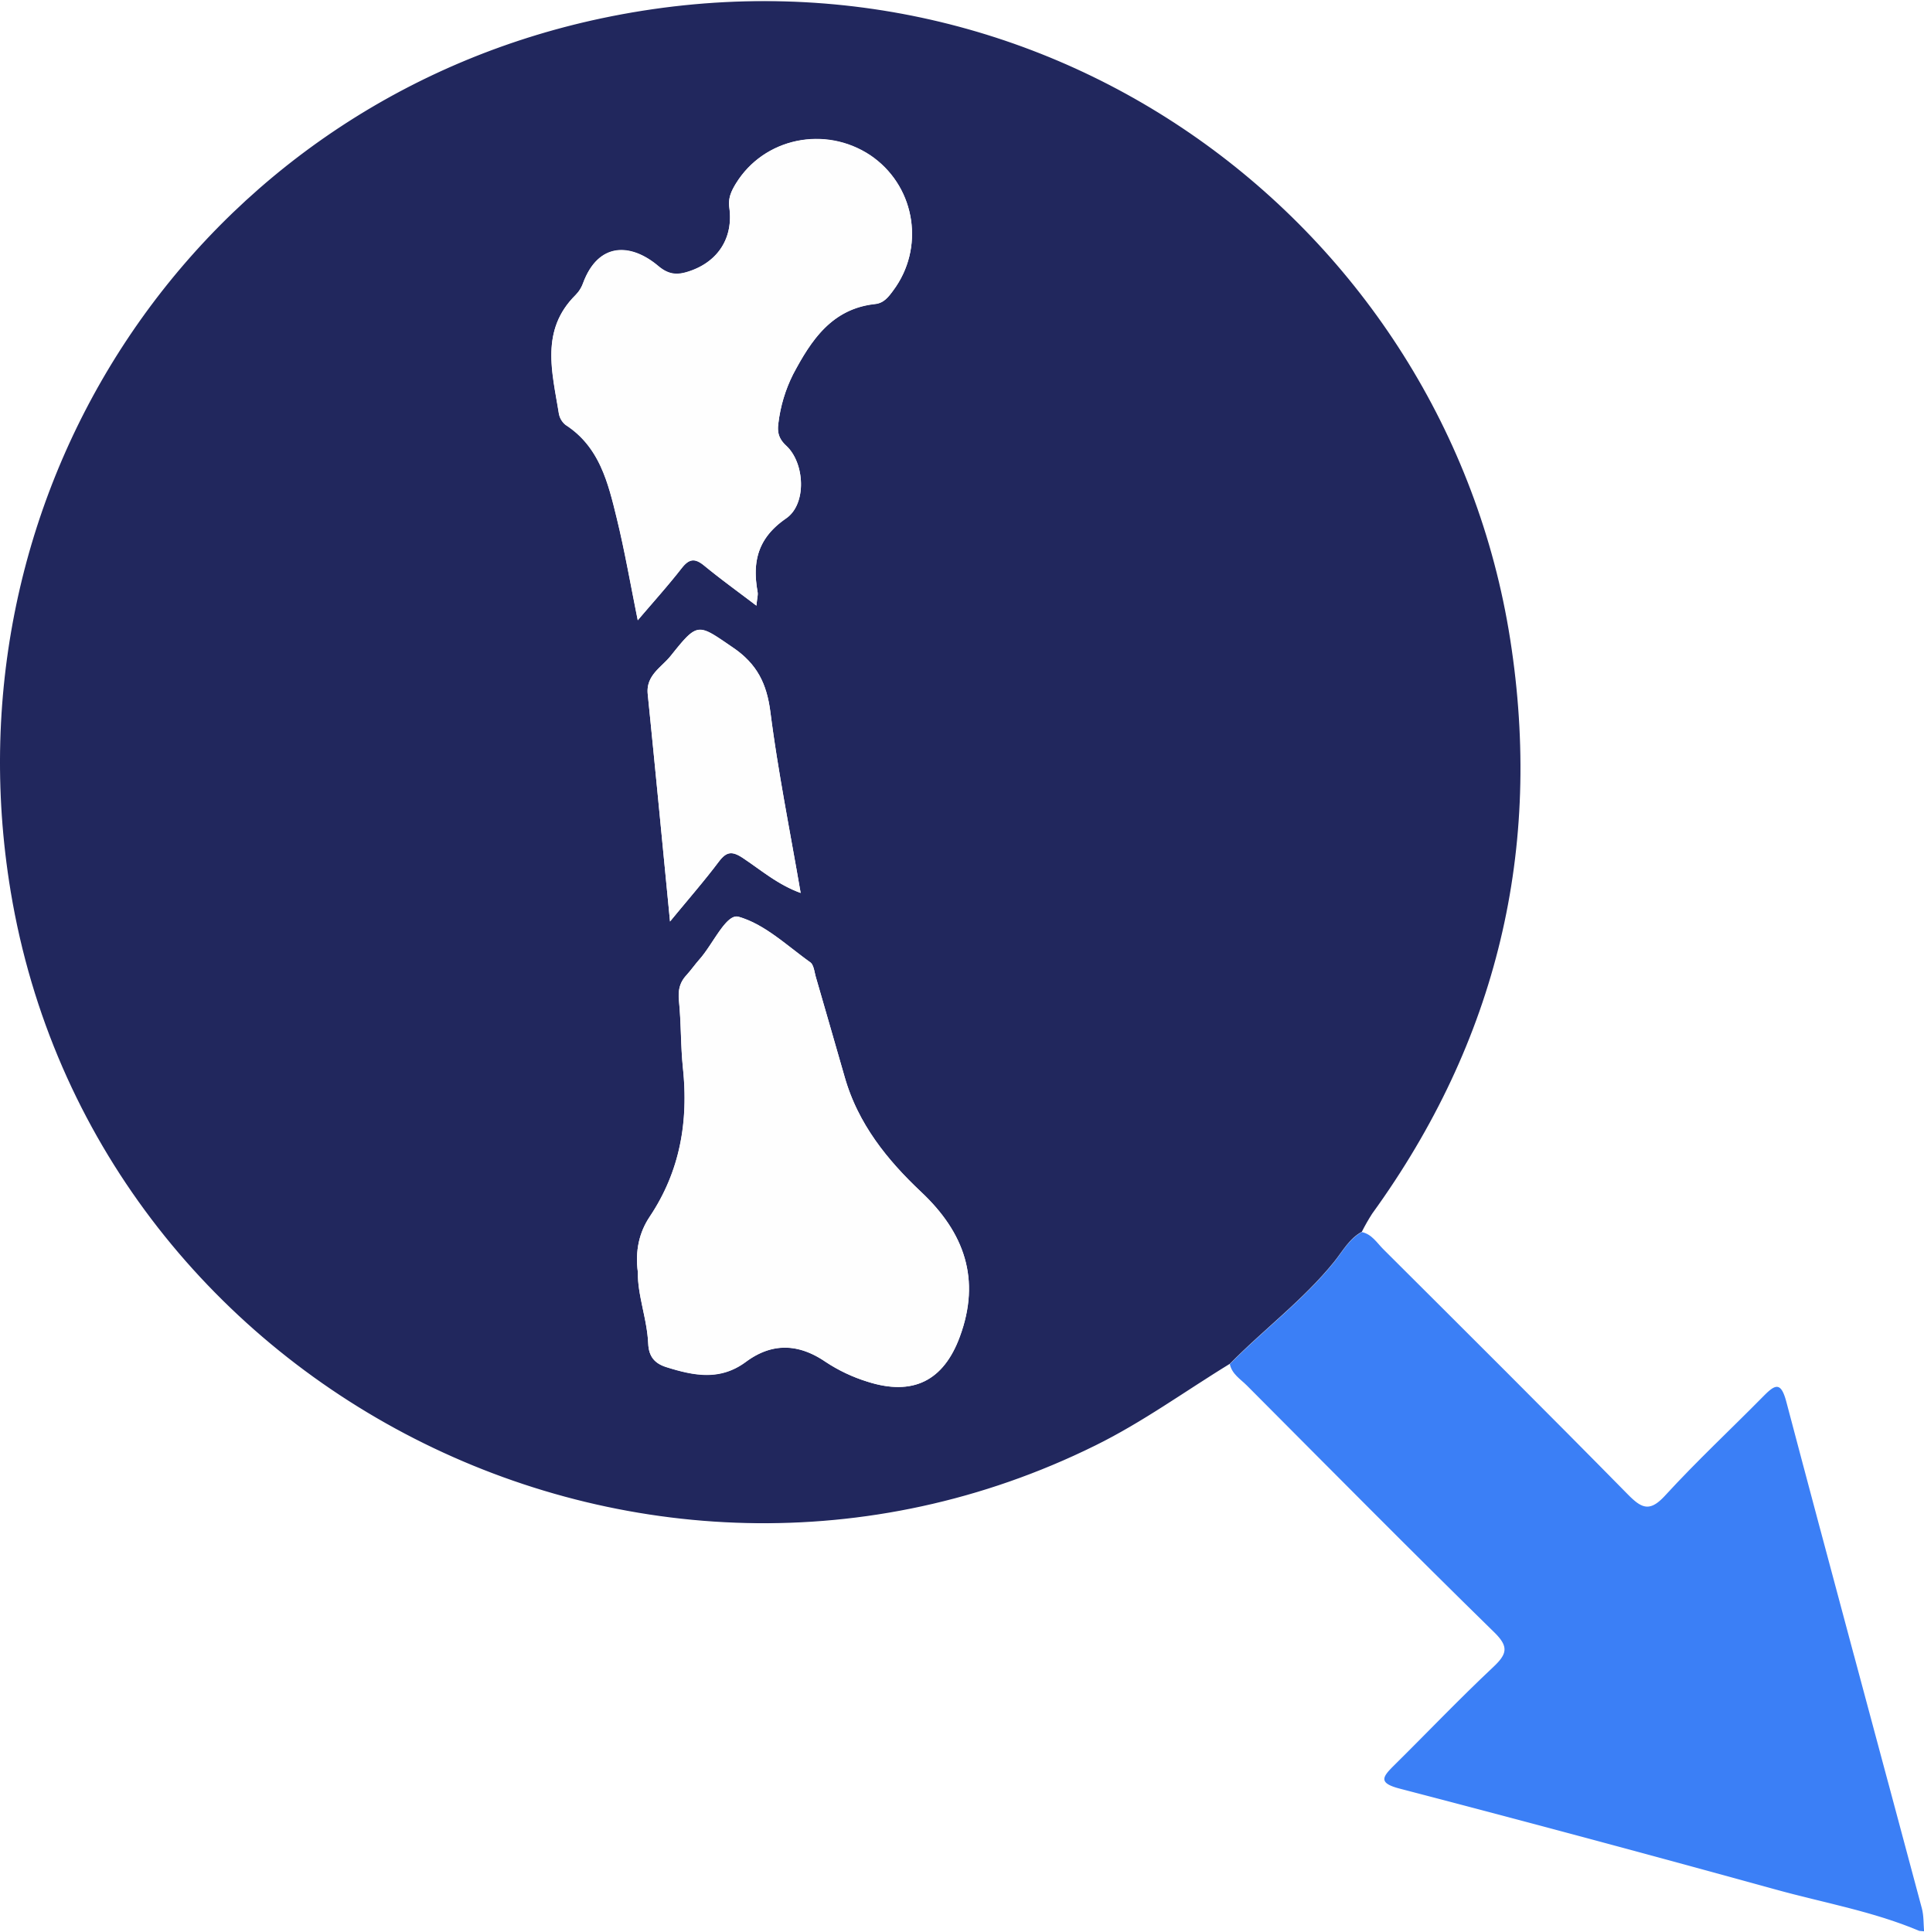

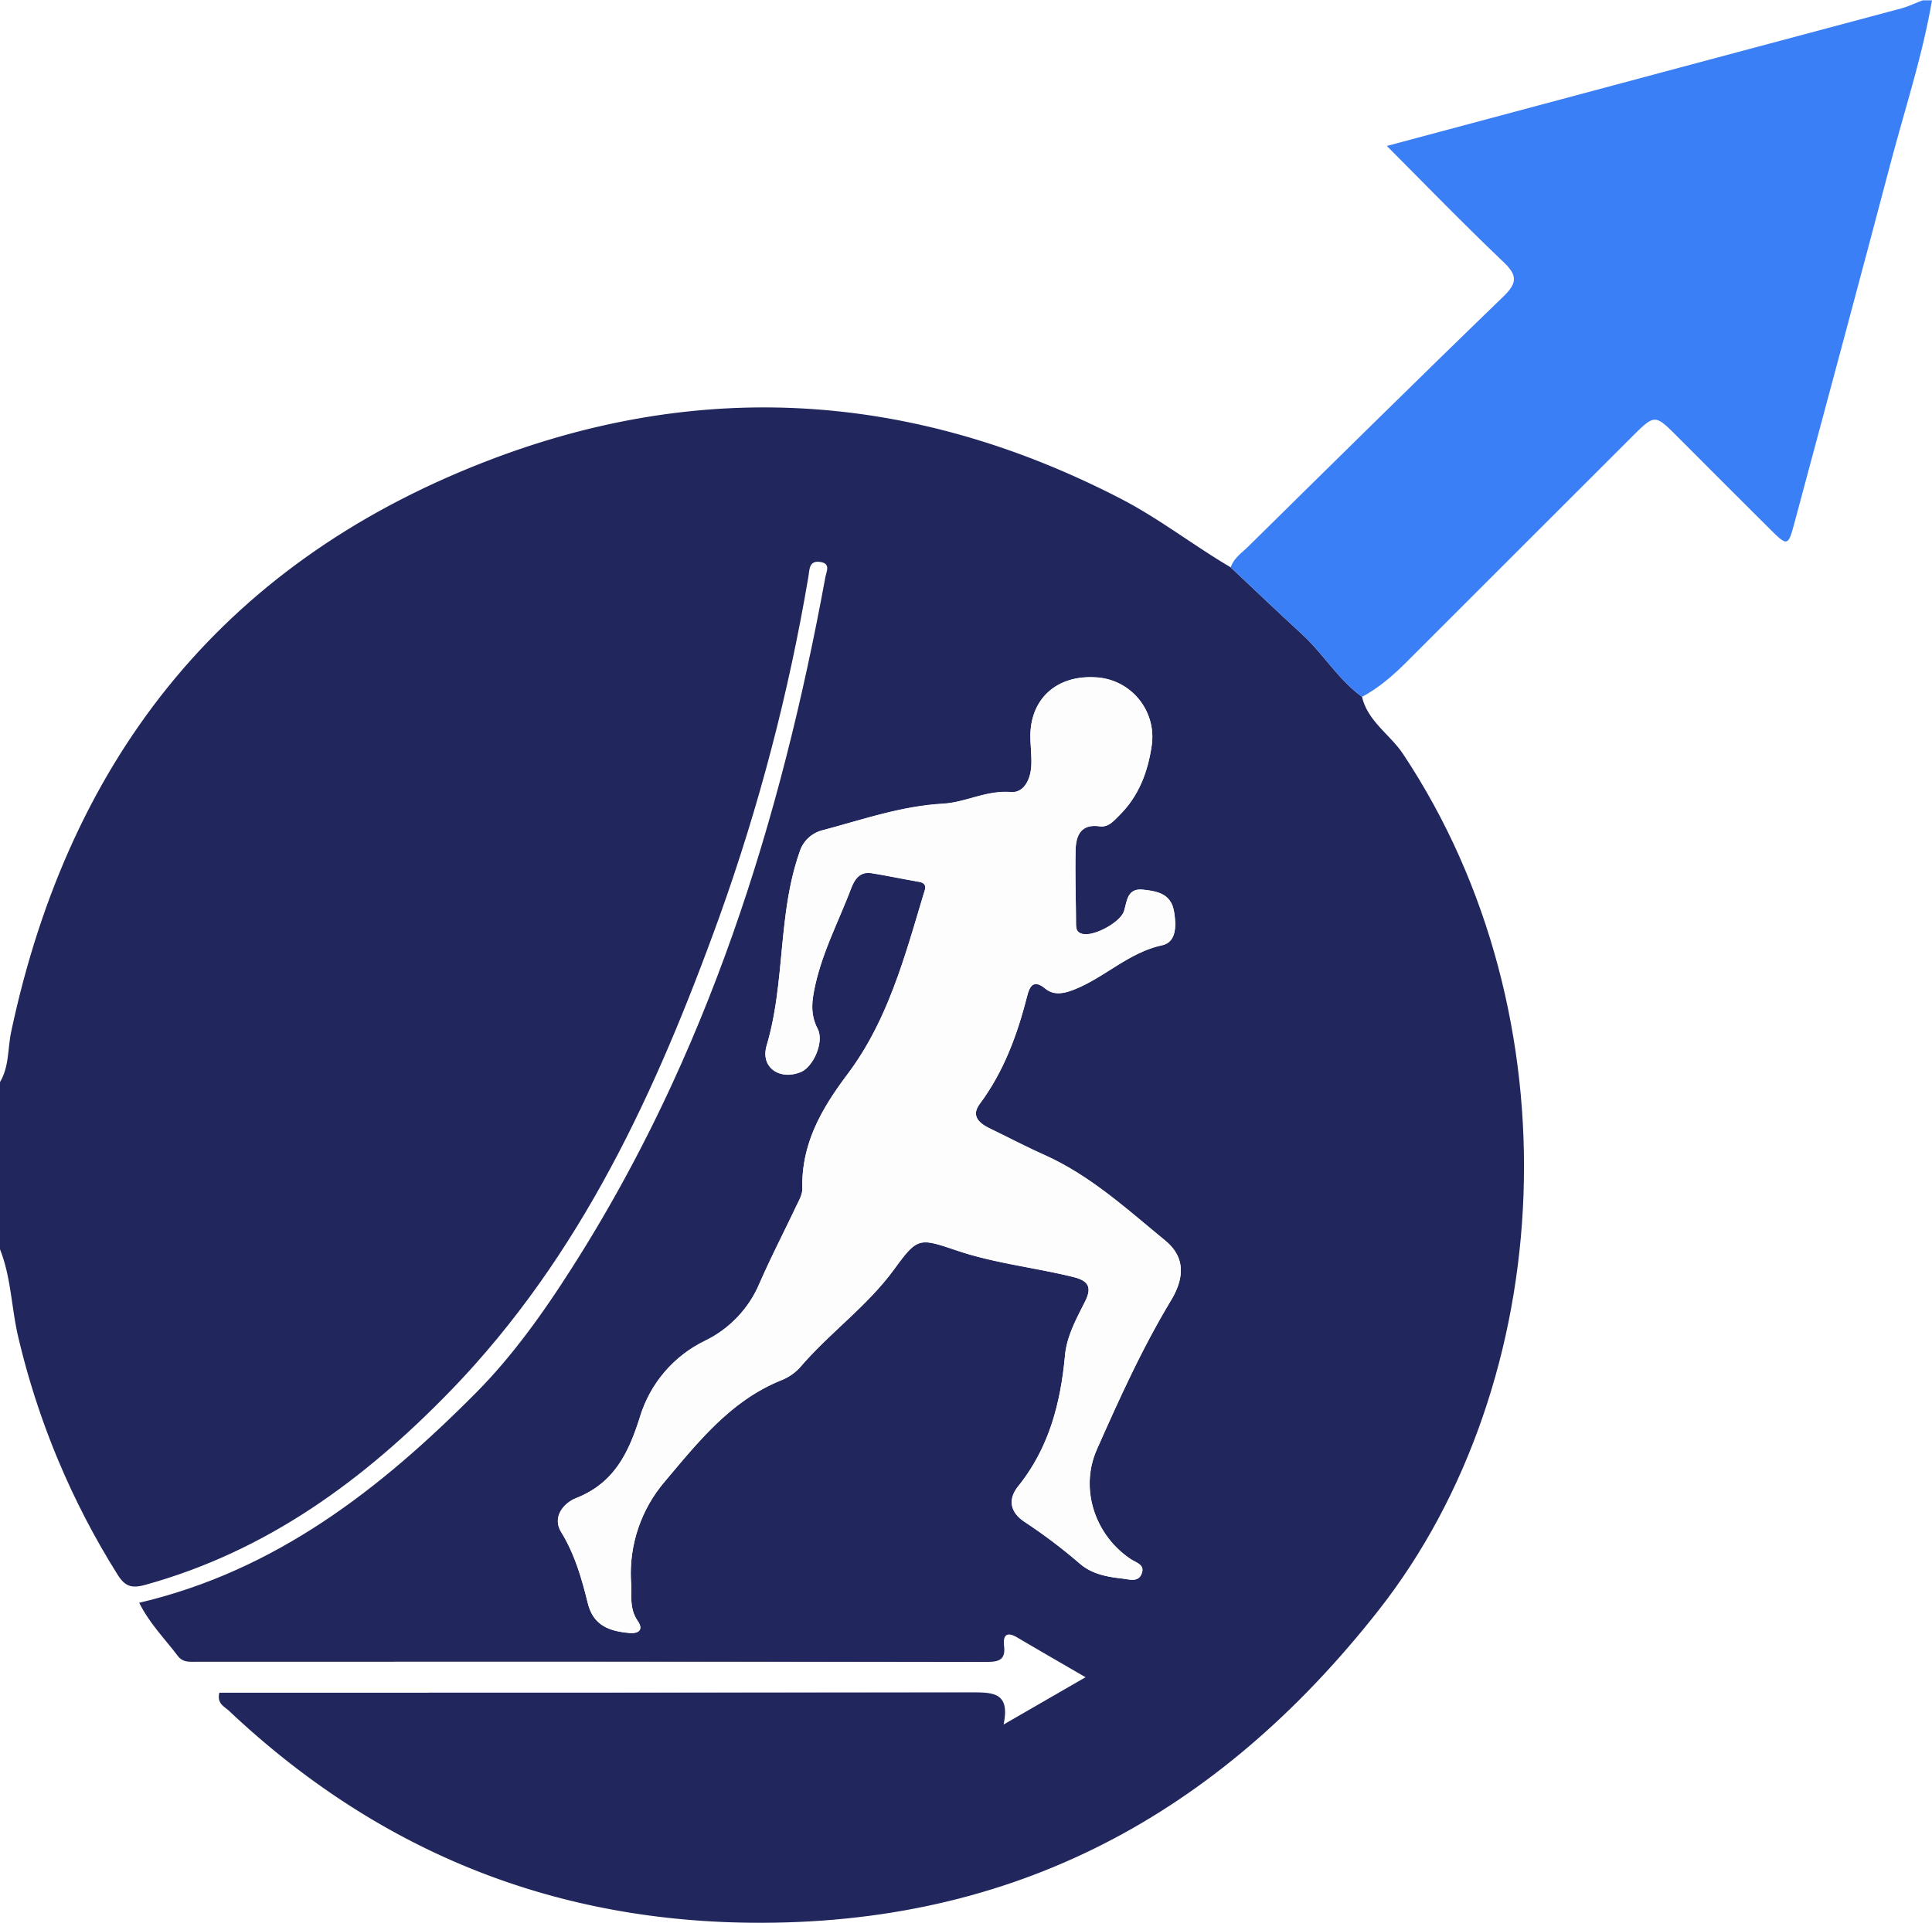
AO’s Fracture Management Principles Revolutionized Fracture Care
Fracture Realignment
Fracture Fixation
Early Mobilization
Soft-tissue Preservation
Notes:
Similar to the way French hospitals revolutionized the physical diagnosis of patients in the 19th century, not by inventing something new but by standardizing, making routine and measuring the effects of the principles of inspection, palpation, percussion and auscultation, the AO enabled a similar sea change to happen for internal fracture fixation.
It is no exaggeration to claim that the AO changed the world for the better for millions of patients.

Slide 11
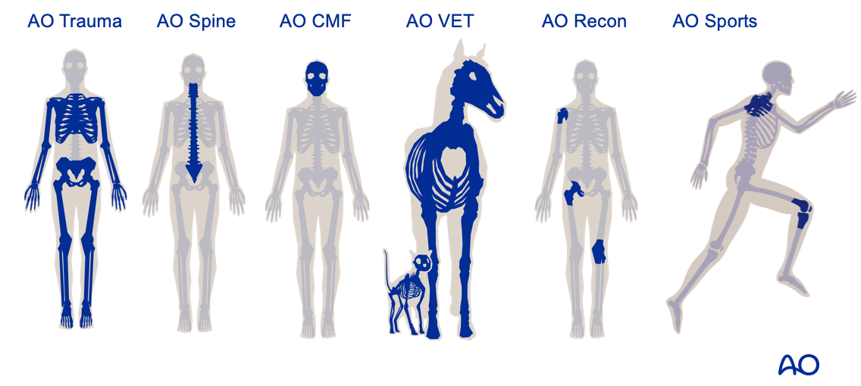
AO History Cont.
AO Foundation (1958 Society/1984 Foundation)
- A medically guided, not-for-profit, global network of health-care professionals
AO VET (1969)
AO SPINE (2003)
AO CMF (2008)
AO TRAUMA (2008)
AO RECON (2014)
…. AO SPORTS (initiative began in 2020)
AO Regions
AO NA (1992)
AO Asia Pacific (1994)
AO Latin America (1998)
AO Middle East (2006)
Notes:
To give a perspective of the size, depth and impact of AO…
Under the grouping of the AO Foundation (year established in parentheses) are the specialties of trauma, CMF, Spine, Veterinary surgery and as of April 2020, Sports
This may be beyond the scope of the presentation - If you agree, can remove the below content and the AO Regions text box above
Not to confuse you, there are also various regions as you can see on the right with the by far largest region in terms of financial impact is AO NA.
The AO Foundation also has other non-clinical areas including research – basic science and clinical research, innovation and education

Slide 12
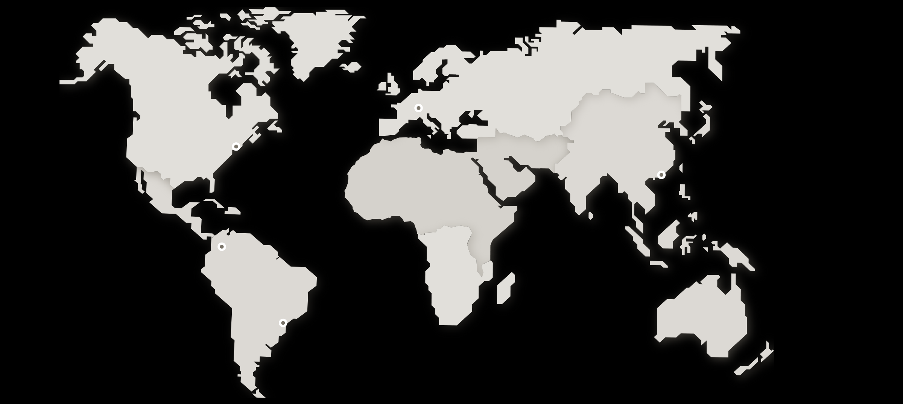



AO: Scope
More than 1 million participants in AO courses to date
AO educates more than 82,600 participants in over 870 educational events annually, and has an international teaching faculty of 8,000 experts
The AO is a network of 520,000 health-care professionals in over 160 countries

Slide 13
AO History Cont.
2015 Synthes sold by Dr. Hansjoerg Wyss to J&J for 19.7 billion with >1 billion donation to the AO Foundation
Strategic Partnership with J&J MedTech
Notes:
A frequently asked question is: “Is AO affiliated with industry?” The answer is no and yes. In the truest sense, the answer is no as the AO Foundation is a separate self-funded entity. The funding was assured in 2015 when ….
The answer is also partly, yes as it is necessary to have technical assistance from industry as the courses uses implants. However, clear instructions for faculty are given that no mention of implants or companies are to be used in any of the presentations. To also support this strong dividing line of industry free bias, AO course are CME events and focus on teaching principles rather than techniques

Slide 14
AO Sports Courses
Principles (Tactile models)
Ideal Audience: PGY 2-3 Orthopaedic Residents
Advanced (Tactile models)
Ideal Audience – PGY 4-5 Residents; Fellows; Junior Faculty
Master (Cadaver)
Ideal Audience – Experienced Surgeons

Slide 15
AO Sports: Principles of Sports Medicine Course - The Joint is an Organ
2 Day Course Involving Knee and Shoulder
– Focus on Case Based Discussions/Interaction and Hands on Exercises
Module 1 – Anatomy and Biomechanics
Module 2 – Physical Examination, Imaging and Classification
Module 3 – Principles of Surgical Set Up, Arthroscopy and Fixation Techniques
Module 4 – Arthroscopic and Open Approaches for the Knee and Shoulder
Module 5 – Joint-Specific Surgical Techniques and Rehabilitation

Slide 16
Other AO Sports Courses: Advanced Knee; Advanced Shoulder
Knee 2.5 Day Course – Tactile Knee Model
Module 1 – Anatomy and Biomechanics
Module 2 - Practical Exercise – Meniscal Repair
Module 3 - Reconstruction of Anatomy for Superior Stability
Module 4 - Practical Exercise – Reconstruction of the Central Pivot
Module 5 – Practical Exercise- Peripheral Instability: Corners of the Knee
Module 6 – Practical Exercise – Alignment of the Knee
Module 7– Complex Cases
Module 8 – Failures & Revision Strategies
Shoulder
2 Day Course – Tactile Shoulder Model
Module 1 – Anatomy and Biomechanics
Module 2 - Practical Exercise Rotator Cuff (Cuff, Biceps, Pec Major)
Module 3 - Complex Rotator Cuff (Subscapularis, SCR, LTT)
Module 4 - Practical Exercise Complex Rotator Cuff
Module 5 - Shoulder Instability (Bone Loss/Remplissage/HAGL; AC Joint)
Module 6 - Practical Exercise Shoulder Instability
Module 7 - Shoulder Arthroplasty
Notes:
While not the focus of this presentation, I want to take a few moments so share some of the other more advanced courses for senior residents and faculty…

Slide 17
Other AO Sports Courses Master Knee; Master Shoulder
Master
Knee – Patellofemoral
Strategic Partnership with Fulkerson Society
Tactile Patellofemoral Model
Shoulder - Tendon Transfers
Strategic Partnership with Boston Shoulder Institute
Cadaver Course

Slide 18
AO Sports – Past Principle Course Details
AO Principle Courses
Denver, CO
Chicago, IL
Nashville, TN
Phoenix, AZ
Davos, CH
Cologne, GER
Berlin, GER
Bogota, COL
Participating Residency & Fellowship Programs
Boston University
East Tennessee State University
Jack Houston Memorial Hospital
Loma Linda
Mayo Clinic
Naval Medical Center San Diego
Oregon health and science
Rush
Stanford University
Steadman Clinic
SUNY upstate
UC Davis
UCLA
UCSF
University of Colorado
University of Connecticut
University of Florida
University Kentucky
University Mississippi
University of Missouri
University of Pittsburgh
University of Rochester
University of Tennessee - Chattanooga
University Texas Austin
University of Toronto
University of Utah
University of Vermont
Valley Consortium
Wake Forest
Washington University
WellStar
Yale University
Notes:
So far we have held 5 Principles Courses in the US and many outside of the US
Several residency and fellowship programs have participated including…

Slide 19
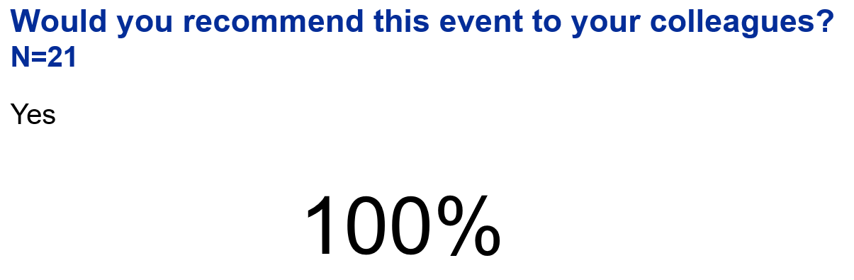
AO Sports Principles Course Resident Reviews
Quotes/Feedback
I learned much that I plan to use in my practice – particularly ligament reconstructions and osteotomies
The course as it was very informative and interactive. I loved the practical exercises.
Outstanding discussion and practical simulations
​Entire event was very interactive and useful.
Very well organized
Lots of bone models with enough time for practice.
Faculty were always there to answer your questions and provide support during the practical skills.
The faculty were interested in teaching and getting to know the residents.

Slide 20

AO Sports - Principles & Advanced Course Grants
Complete Internal budget which will be used when submitting the grant
Get internal approvals from department and/or leadership to support any expenses the grant doesn’t cover
Complete application on DePuy’s website https://engagegrantsna.powerappsportals.com/
Will receive an email from Meghan Mailhot if grant is awarded
Process is nearly identical to grants for the AO Trauma Principles Course
Residencies only submit one application for a group of residents to attend
Note:
- DePuy grant is usually $1000 to 1500 per resident/fellow which covers the majority of the costs (DePuy historically only supports housing, airfare and registration expenses)
- Madison Pearson, the Program Coordinator at University of Missouri is able to help answer questions and assist with the grant process (pearsonmp@health.missouri.edu)
Only one DePuy resident/fellow grant is able to be given to each resident/fellow each calendar year (i.e. unable to receive grant to attend both AO Trauma and AO Sports Course in one year)
They do not award PGY1 level residents (only PGY2 – Fellow)

Slide 21
Faculty Development Opportunities
As this is a new initiative we are actively pursing faculty who have a passion for teaching.
- If you or if you have a sports faculty who may be
interested in participating, please reach out to us
- The following 3 slides are faculty who have participated in Principles, Advanced and Master AO Sports Courses

Slide 22
AO Sports Participating Faculty (Principles, Advanced and Master Courses)
Abboud, Joseph - Philadelphia, PA, USA - Rothman Orthopedic Institute
Al Thani, Saeed - Dubai, N/A, UAE - Orthocure Medical Center
Amini, Michael - Phoenix, AZ, USA - The CORE Institute
Athwal, George - London, Canada - St Josephs Health Care
Barco, Raul - Madrid, Spain - Hospital La Paz
Berkson, Eric - Boston, MA, USA - Mass General Brigham
Boileau, Pascal - Nice, France - ICR, Clinique KANRYS Center, Grope KANTYS
Brady, Jacqueline - Portland, OR, USA - Oregon Health & Science University
Brown, Leah - Scottsdale, AZ, USA - Banner University Orthopedics & Sports Medicine Institute
Calvo, Emilio - Madrid, Spain - Fundacion Jimenez Diaz
Cancienne, Jourdan - Chicago, IL, USA - Rush University Medical Center
Chahla, Jorge - Hinsdale, IL, USA - Midwest Orthopaedics at Rush
Cohen, Moises - São Paulo, Brazil - University federal de Sao Paulo and Hospital Albert Einstein
DeFroda, Steven - Columbia, MO, USA - University of Missouri-Columbia
Denard, Patrick – Medford OR, USA – Southern Oregon Orthopedics
Dennis, Elizabeth - New York, NY, USA - Mount Sinai
Drager, Justin - Montreal, Canada - McGill Univeristy Health Center
Farmer, Kevin - Gainesville, FL, USA - The University of Florida
Favorito, Paul - Cincinnati, OH, USA - The Christ Hospital
Fortier, Lisa - Fort Collins, CO, USA - Colorado State University
Frank, Rachel - Denver, CO, USA - University of Colorado
Gupta, Ashish - Brisbane, Australia - Greenslopes Pvt Hospital
Hall, Kimberly - Portland, OR, USA - OHSU
Hasan, Samer - Cincinnati, OH, USA - The Jewish Hospital - Cincinnati Sportsmedicine

Slide 23
AO Sports Participating Faculty (Principles, Advanced and Master Courses)
Herzberg, Guillaume - Lyon, France - Clinique Parc Lyon, Val Ouest Lyon
Hubbard, David - Morgantown, WV, USA - West Virginia University
Jaeger, Martin - Freiburg, Germany - University Medical Center
Joyner, Patrick - Collier County, FL, USA - OrthoCollier
Kany, Jean - Saint Jean, France - Clinique de l’union
Katthagen, J. Christoph - Münster, Germany - University Hospital Münster
Keener, Jay - St Louis, MO, USA - Washington University
Kfuri, Mauricio - Columbia, MO, USA - University of Missouri - Columbia
Knapik, Derrick - St. Louis, MO, USA - Washington University in St. Louis School of Medicine
Lafosse, Laurent - Sevrier, France - ALPS Surgery Institute
Lee, Cassandra - Sacramento, CA, USA - UC Davis Health
Lohre, Ryan - Boston, MA, USA - Massachusetts General Hospital
Ma, Richard - Columbia, MO, USA - University of Missouri
Mair, Scott - Lexington, KY, USA - University of Kentucky
Martin, Ryan - Calgary, Canada - University of Calgary
McCarty, Eric - Boulder, CO, USA - University of Colorado
McDonald, Lucas - San Diego, CA, USA - Naval Medical Center San Diego
Medvecky, Michael - New Haven, CT, USA - Yale New Haven Hospital
Mihata, Teruhisa - Takatsuki, Japan - Osaka Medical and Pharmaceutical University
Musahl, Volker - Pittsburgh, PA - UPMC
Nawabi, Danyal - New York, NY, USA - Hospital for Special Surgery
Nuelle, Clayton - Columbia, MO, USA - University of Missouri
Okoroha, Kelechi - Rochester, MN, USA - Mayo Clinic
Parisien, Robert - New York, NY, USA - Mount Sinai Health System

Slide 24
AO Sports Participating Faculty (Principles, Advanced and Master Courses)
Partezani Helito, Camilo - São Paulo, Brazil - University of São Paulo
Patzkowski, Jeanne - San Antonio, TX, USA - Brooke Army Medical Center
Pérez-Salazar, Diego - Mexico DF, DF, Mexico - ABC Medical Center
Ponce, Brent - Columbus, GA, USA - Hughston Clinic
Saithna, Adnan - Cave Creek, AZ, USA - AZBSC Orthopedics
Sanchez-Sotelo, Joaquin - Rochester, MN, USA - Mayo Clinic
Savoie, Felix - New Orleans, LA, USA - Tulane University
Sherman, Seth - Stanford, CA, USA - Stanford Medicine
Shybut, Theodore - Van Nuys, CA, USA - Southern California Orthopedic Institute
Song, Daniel - Bethesda, MD, USA - Walter Reed National Military Medical Center
Stannard, James - Columbia, MO, USA – University of Missouri
Su, Charles - Charlottesville, VA, USA - University of Virginia
Sullivan, Jaron - Nashville, TN, USA - Vanderbilt Orthopaedics
Sutton, Karen - New York, NY, USA - Hospital for Special Surgery
Tanaka, Miho - Boston, MA, USA - Massachusetts General Hospital
Tashjian, Robert - Salt Lake City, UT, USA – University of Utah
Tennent, David - Olmos Park, TX, USA - Brooke Army Medical Center
Twaddle, Bruce - Auckland, New Zealand - Auckland City Hospital
Valenti, Phillipe - Paris, France - Institut de la Main Shoulder Unit
Vidal, Armando - Edwards, CO, USA - The Steadman Clinic / Steadman Philippon Research Institute
Warner, Jon - Boston, MA, USA - Massachusetts General Hospital
Werthel, Jean-David - Paris, France - Hospital Ambroise Paré - AP-HP
Westermann, Robby - Iowa City, IA, USA - University of Iowa Hospitals and Clinics
Wieser, Karl - Ebmatingen, Switzerland - Balgrist University Hospital
Zumstein, Matthias - Bern, Switzerland - Orthopädie Sonnenhof

Slide 25
Thanks & Questions?
Brent Ponce, MD
bponce@hughston.com
James Stannard, MD
stannardj@health.missouri.edu
Selina Ziswiler selina.ziswiler@aofoundation.org

